Slide 1
Cincinnati Reds Hackathon - Pitcher Roles Reversal
Anna Pierce, Will Cave, James Young, Rob White, Matthew Reedy
Notes:
Matthew reedy

Slide 2
Data
01
02
03
04
FanGraphs
Baseball Savant
Season by Season data for Relievers and Starting Pitchers
Models for Stuff and Command
Batted Ball Metrics
2021-23 Pitch by Pitch Data
Calculated Pitch Data and Batted Ball Metrics
PitchingBot
Our clients
Mars is red and actually quite cold
Notes:
Matthew -> relied heavily on fangraphs season level

Slide 3
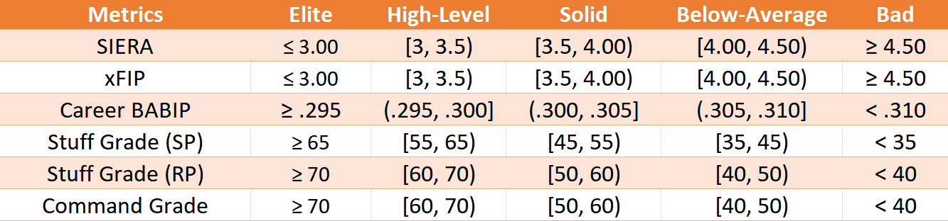
Pitching Classification
Notes:
Anna

Slide 4
Methodology
01
02
03
XGBoost - Pitcher Identification
Random Forest - Pitcher Projection
Stuff and command-based
Identified pitchers with the arsenal to switch roles
Predicts: SIERA, xFIP, WAR
Built on: Stuff, Command, K%, BB%, Exit Velocity, selected batted ball metrics
Notes:
Will - #1 only (mention that we will get to rf later)

Slide 5
Identifying Pitchers
01
02
03
04
Classification
Prediction
Tiers based on SIERA, xFIP, career BABIP, Stuff, and Command
Based on individual pitch stuff & command
Accuracy
Selection
57.3% - Exact Tier
96.1% - Within one tier
“Good,” “High-Level”,
Or “Elite” by model
Notes:
Will

Slide 6
XGBoost Model Results
Returned 28 relievers that could succeed in a starting role
Prediction | Bad | Mediocre | Good
Bad | 13 | 10 | 2
Mediocre | 8 | 16 | 7
Good | 5 | 6 | 22
Selected A.J. Puk (MIA) and Tim Herrin (CLE)
Notes:
Will

Slide 7
Methodology
01
02
03
XGBoost - Pitcher Identification
Random Forest - Pitcher Projection
Stuff and command-based
Identified pitchers with the arsenal to switch roles
Predicts: SIERA, xFIP, WAR
Built on: Stuff, Command, K%, BB%, Exit Velocity, selected batted ball metrics
Notes:
Anna -> now explain #2 - random forest

Slide 8
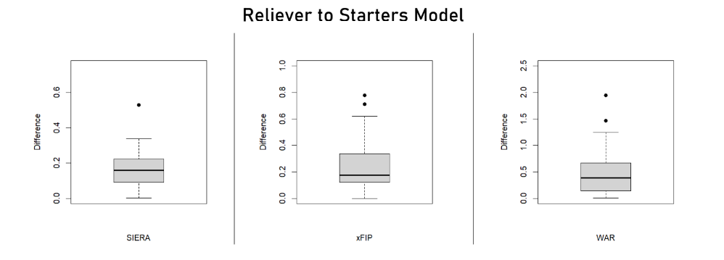
Model Accuracy: Reliever to Starter
Notes:
Difference in actual vs. predicted -> training & test data both consist of only starter data
Built on starter data to predict reliever to starter
SIERA RMSE: 0.72
xFIP RMSE: 1.4
WAR: 0.69

Slide 9
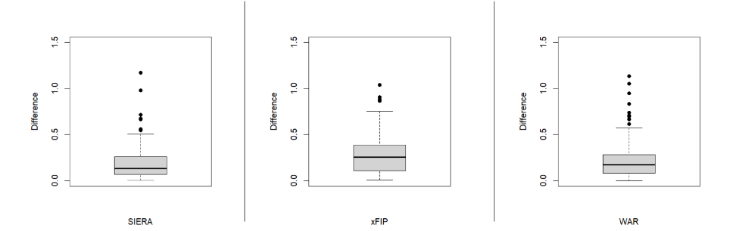
Model Accuracy: Starter to Reliever
Notes:
Difference in model prediction vs actual stats -> built on only reliever data
Built on reliever data to predict starter to reliever
SIERA RMSE: 0.89
xFIP RMSE: 1.4
WAR RMSE: .22

Slide 10

A.J. Puk
Finished with a 0.9 fWAR
62.5% Save Percentage
Starter in the Minors
4 Pitch Arsenal
Notes:
Worse SIERAs and xFIPs, but that is to be expected with the increased workload -> Matt

Slide 11
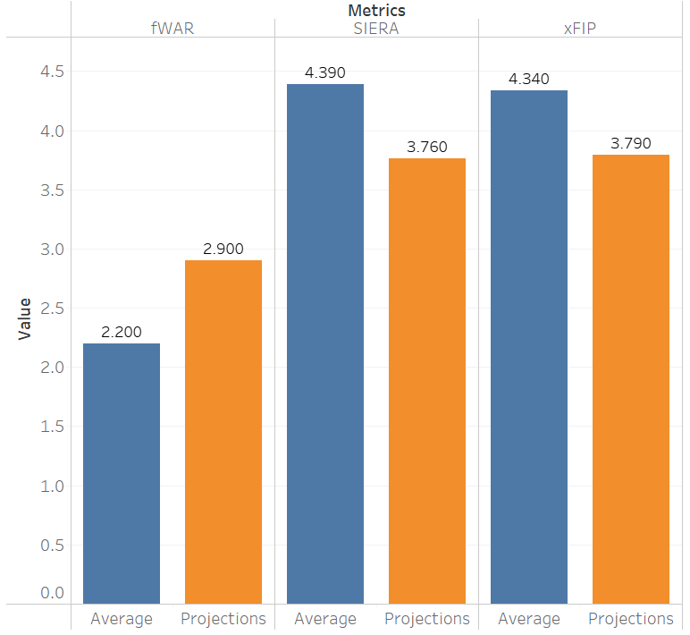
Projections

Slide 12

Tim Herrin
Finished with a 0.1 fWAR
Up and Down From Minors
Underperformed Expected Statistics
4 Pitch Arsenal
Notes:
Expected stats are worse than actual on all but his slider, his SIERA and xFIP are expected to be worse in our projections but that is to be expected with the increased workload but overall production will be more valuable as a starter than as a reliever

Slide 13
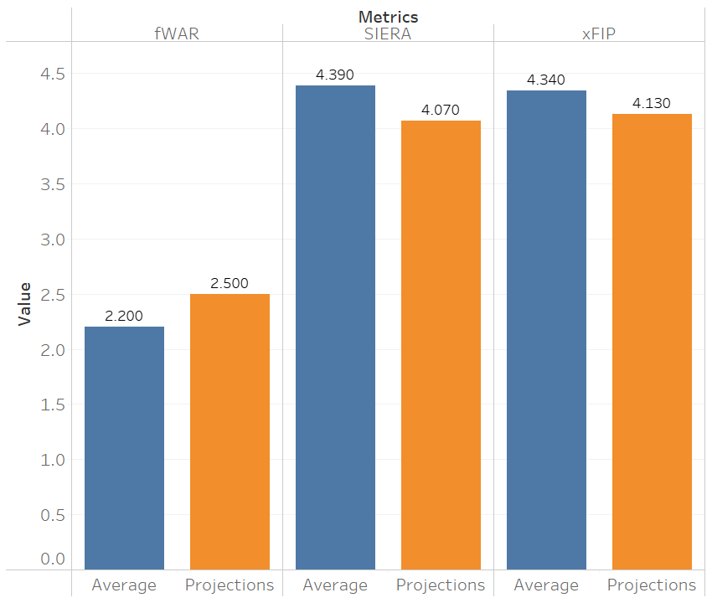
Projections
Notes:
Even with relatively high xFIP and SIERA projections fangraphs has CLE as a top 15 team in DRS and Range and top 10 in OAA

Slide 14
Questions?
Notes:
James

